Slide 1
notes
NEED Whiteboards & Element Signs for forming atoms
See teacher notes on lesson
Edit this to avoid repetition after we have learned it

Slide 2
Periodic Trends
Elemental Properties and Patterns
Notes:
any gizmos? Other videos or animations, history anecdotes etc

Slide 3
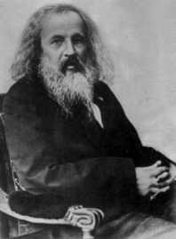
The Periodic Law
Dimitri Mendeleev was the first scientist to publish an organized periodic table of the known elements.

Slide 4
The Periodic Law
Mendeleev even went out on a limb and predicted the properties of 2 at the time undiscovered elements.
He was very accurate in his predictions, which led the world to accept his ideas about periodicity and a logical periodic table.

Slide 5
The Periodic Law
Mendeleev understood the ‘Periodic Law’ which states:
When arranged by increasing atomic number, the chemical elements display a regular and repeating pattern of chemical and physical properties.

Slide 6
The Periodic Law
Atoms with similar properties appear in groups or families (vertical columns) on the periodic table.
They are similar because they all have the same number of valence (outer shell) electrons, which governs their chemical behavior.

Slide 7
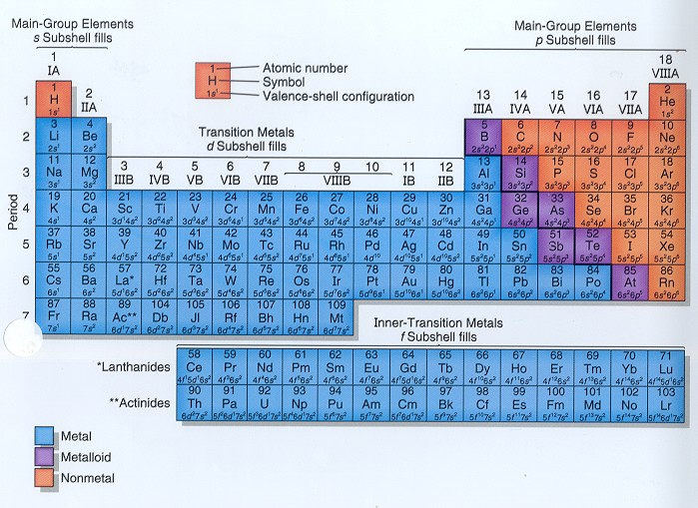
Metals, Nonmetals, Metalloids

Slide 8
Periodic Trends
There are several predictable trends in properties that you should know.
The first and most important is atomic radius.
Radius is the distance from the center of the nucleus to the “edge” of the electron cloud.

Slide 9
Atomic Radius
(for interest only slide)
Since a cloud’s edge is difficult to define, scientists use covalent radius, or half the distance between the nuclei of 2 bonded atoms.
Atomic radii are usually measured in picometers (pm) or angstroms (Å). An angstrom is 1 x 10⁻¹⁰ m.
2.86 Å
1.43 Å
1.43 Å

Slide 10
In your partners
Partner A → Draw B-R of Li
Partner B → Draw B-R of Na
Discuss → which is larger and why?
Stand up if you are the largest atom
Explain
BUT Na is even larger than is anticipated from the added energy level → WHY?
Notes:
For Na, shielding reduces the effective charge on the outer electron so it moves further out.

Slide 11
Activity - Class as an atom
Following the activity, predict the following:
Smallest atom on the P.T.
Largest atom
Partner A: predict largest of Cl, Br, I
Partner B: predict largest of B, Li or F
Explain your prediction to your partner

Slide 12
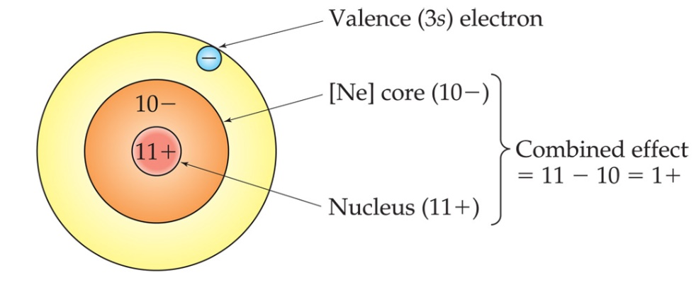
Core Charge (CC)
Core charge is a measure of the attractive force on the outer (valence) electrons
Core Charge = (# protons) – (# inner electrons)
Calculate core charge for Na and Cl

Slide 13
Core Charge calculations
CC_{Na} = 11-10= +1
CC_{Cl} = 17-10= +7
Effect on atomic radii?
Notes:
Fyi – same as valence electrons

Slide 14
Homework
Complete the predicted graph of atomic radii, noting positions of H, Li,Na and K
WHAT ORDER SHOULD YOUR X-AXIS DATA BE IN?
Complete Part 1 of Trends activity sheet
Complete Trends question sheet #1-4

Slide 15
DAY 3

Slide 16
Your Graphing assignment
Compare!
What elements corresponded to the peaks?
What elements corresponded to the troughs?
What did you predict for F? Co? Rb?
Any data that didn’t make sense (anomaly)?

Slide 17
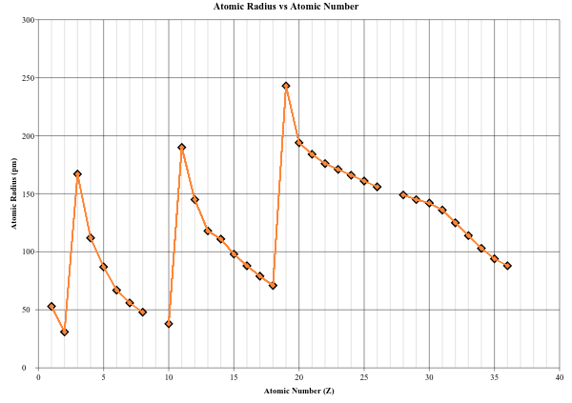
Notes:
No anomalies to discuss for radius, student data is missing F (9), Cobalt (27) and Rubidium (37—new peak)

Slide 18
Ionization Energy
Amount of energy (in kJ) required to remove an electron from the ground state of a gaseous atom or ion.
Partner A: predict the trend across a period (will the energy increase to the left or to the right?). EXPLAIN.
Partner B: Predict the trend down a group. Explain

Slide 19
Graphs
Have Atomic Radius Graph out for a signature
Complete Ionization graph.

Slide 20
NOTES LIVE NOW TO PRINT FOR TOMORROW.
{Check I’ve made them live :) }

Slide 21
Day 4

Slide 22
Your I. E. Graph
Looking at your graph:
Predictions for: F, Co and Rb
Notes:
?? Need to add predictions for ones missing in next graph (may also be asked to predict these on question sheet)
student data is missing F (9), Cobalt (27) and Rubidium (37—new peak)

Slide 23
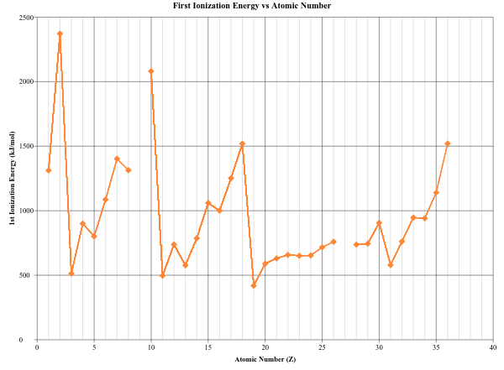
Ionization Energy
The energy required to remove an electron from an atom is ionization energy. (measured in kilojoules, kJ)
The larger the atom is, the easier its electrons are to remove.
Ionization energy and atomic radius are inversely proportional.
Ionization energy is always endothermic, that is energy is added to the atom to remove the electron.

Slide 24
Shielding
As more energy levels are added to atoms, the inner layers of electrons shield the outer electrons from the nucleus.
The effective nuclear charge (Z_{eff}) on those outer electrons is less, and so the outer electrons are less tightly held.

Slide 25
Effective Nuclear Charge [Z_{eff}] (approximated using core charge)
What keeps electrons from simply flying off into space?
Effective nuclear charge is the pull that an electron “feels” from the nucleus.
The closer an electron is to the nucleus, the more pull it feels.
As effective nuclear charge increases, the electrons are pulled in tighter.

Slide 26
Atomic Radius Down a Group
The trend for atomic radius in a vertical column is to go from smaller at the top to larger at the bottom of the family.
Why?
With each step down the family, we add an entirely new energy level to the electron cloud, making the atoms larger with each step.

Slide 27
Atomic Radius Across a Period
The trend across a horizontal period is less obvious.
What happens to atomic structure as we step from left to right?
Each step adds a proton and an electron (and 1 or 2 neutrons).
Electrons are added to existing energy levels.

Slide 28
Atomic Radius Across a Period
The effect is that the more positive nucleus has a greater pull on the electron cloud.
The nucleus is more positive and the electron cloud is more negative (slightly increased electron repulsion but not much).
The increased attraction pulls the cloud in, making atoms smaller as we move from left to right across a period.

Slide 29
Predict Ionic radius
Partner A: How will cation radius compare to its neutral atom?
Partner B: How will anion radius compare to its neutral atom?

Slide 30
Ionic Radius
Cations are always smaller than the original atom.
The entire outer energy level is removed during ionization.
Conversely, anions are always larger than the original atom.
Electrons are added to the outer energy level, increasing electron repulsion and size.

Slide 31
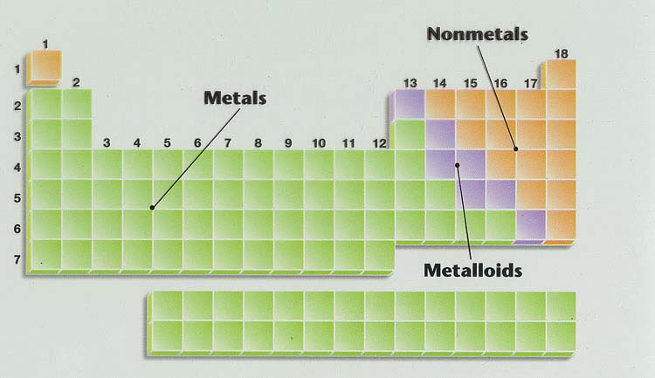
Atomic Radius
Here is an animation to explain the trend.
Above doesn’t work: try this next time (Tylre D) Video for Ionization Energy and Atomic Radius
On your sheet, draw arrows like this:
Notes:
NOTE: animation goes a little into quantum talking about s orbitals but is still good and shows the trend

Slide 32
Practice
Which of the following would have the smallest atomic radius? Why?
Cl⁻, S²⁻ , K⁺, Ca²⁺ , Ar
Notes:
Ca – all have the same electron structure (same number of electrons) but Ca has the greatest number of protons, biggest core charge to attract electrons.

Slide 33
Practice
Complete questions (with proper explanations) on the trends activity sheet
Try questions 9 to 12 on the trends question sheet (ionic radius questions)

Slide 34
Predict!
Using your knowledge of atomic size, will I.E. increase or decrease:
A) Down groups
B) across periods
Complete the graph

Slide 35
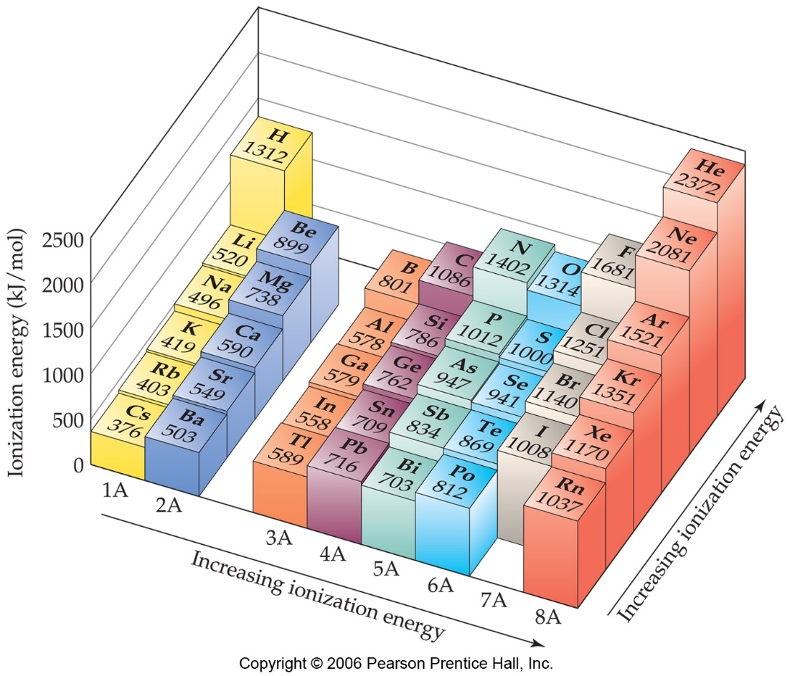
Trends in First Ionization Energies
As one goes down a column, less energy is required to remove the first electron.
For atoms in the same group, Z_{eff} is essentially the same, but the valence electrons are farther from the nucleus.
More shielding

Slide 36
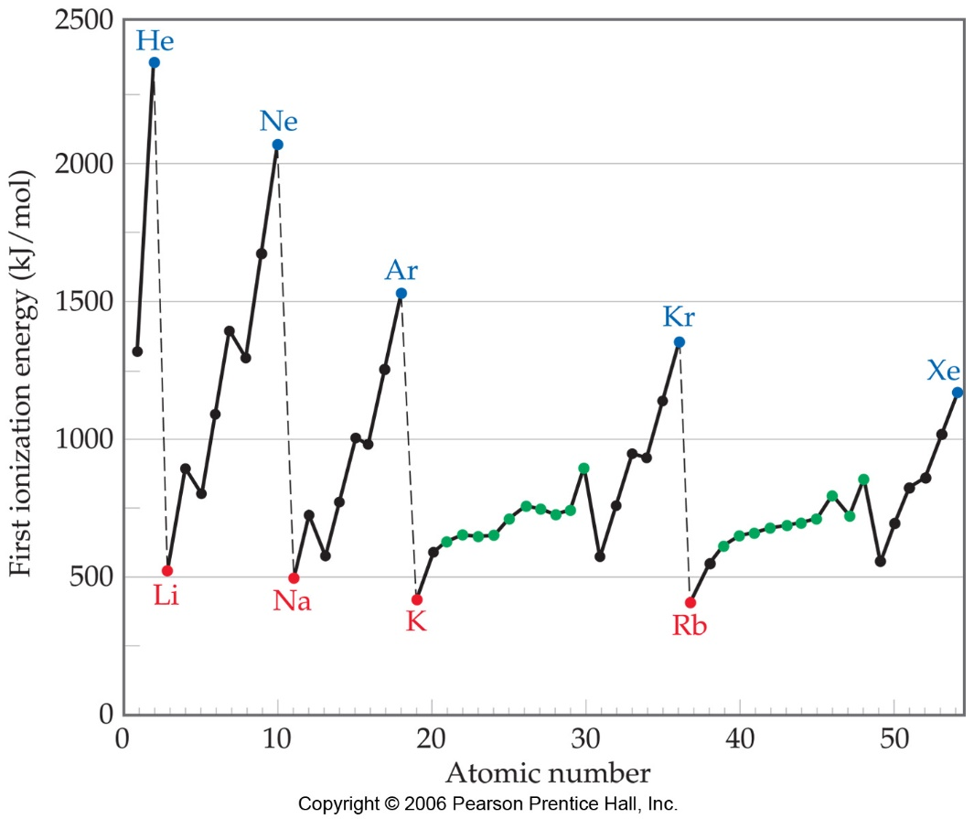
Trends in First Ionization Energies
Generally, as one goes across a row, it gets harder to remove an electron.
As you go from left to right, Z_{eff} increases.
Atomic radii decreases so outer electrons are held more tightly
Notes:
Good look at this for the anamolous peaks (before dips, higher IE’s for half full orbitals or full S orbits so next element dips instead of showing a steady increase across periods).

Slide 37
Ionization Energy (Potential)
Draw arrows on your sheet like this:

Slide 38
This semester
Successive Ionization energy won’t be covered. Do NOT complete questions #13-15 on Periodic Trends Question Sheet.

Slide 39
Successive Ionization Energy
Amount of energy (in kJ) required to remove an electron from the ground state of a gaseous atom or ion.
First ionization energy is that energy required to remove first electron. [Na_{(g)} + energy → Na¹⁺_{(g)} + e⁻]
Second ionization energy is that energy required to remove second electron, etc.
The atom has been “ionized” or charged.
The larger the atom is, the easier its electrons are to remove.

Slide 40
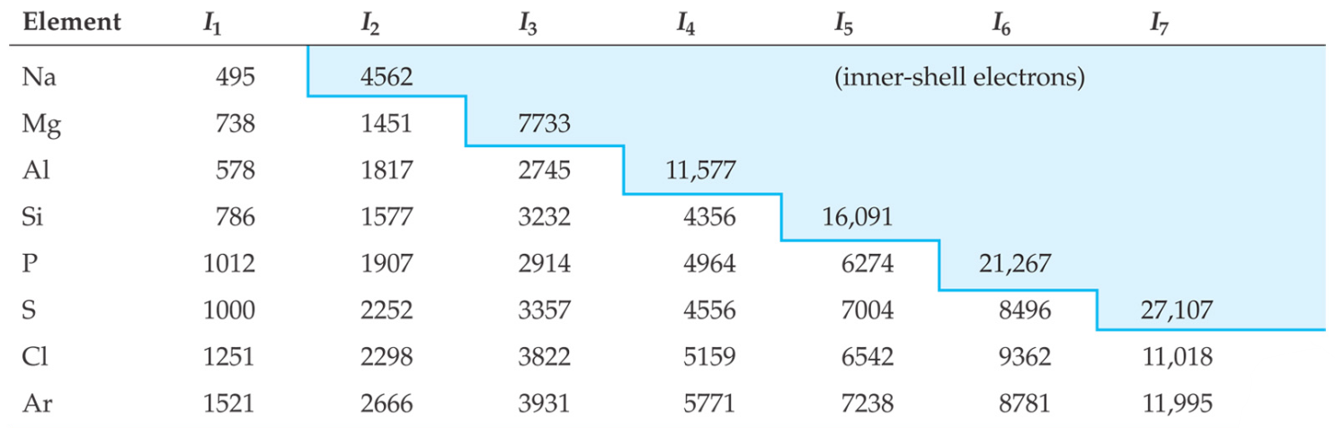
Successive Ionization Energies
It requires more energy to remove each successive electron.
First ionization energy is that energy required to remove first electron. [Na_{(g)} + energy → Na¹⁺_{(g)} + e⁻]
Second ionization energy is that required to remove second electron, etc.
When all valence electrons have been removed, the ionization energy takes a large leap.
Notes:
Use B-R drawing of Be with energy values… from my lesson notes, maybe in teacher docs to remind me

Slide 41
I.E. Calculations
An atom has the following ionization energies. Determine which group in the periodic table it belongs to.
I.E.₁ = 590 kJ/mol I.E.₂ = 1145 kJ/mol
I.E.₃ = 4936 kJ/mol I.E.₄ = 6752 kJ/mol
To determine this, you must identify the largest jump between successive ionization energies. You must divide a higher I.E. by the one that precedes it. Obviously this is not done for the first ionization energy since there is no preceding I.E.

Slide 42
I.E. Calculations
I.E.₂/I.E.₁ = 1145/590 = 1.94 → I.E.₂ is ~ 2x I.E.₁
I.E.₃/I.E.₂ = 4936/1145 = 4.31 → I.E.₃ is ~ 4x I.E.₂
I.E.₄/I.E.₃ = 6752/4936 = 1.37 → I.E.₄ is <2x I.E.₃
The biggest jump occurs between I.E.₂ and I.E.₃ and therefore I.E.₃ is energy required to remove the electron from an inner energy level. Thus, I.E.₁ and I.E.₂ represent the energy required to remove electrons from the outer level; therefore, this atom has two outermost electrons and is in group 2 of the periodic table.

Slide 43
Day 5

Slide 44
Trends and E.A lesson
ON YOUR WHITEBOARD
without your notes, make a list of all factors that affect the trends (eg core charge)

Slide 45
Atomic Radius
Video for Ionization Energy and Atomic Radius
On your sheet, draw arrows like this:
Notes:
NOTE: animation goes a little into quantum talking about s orbitals but is still good and shows the trend

Slide 46
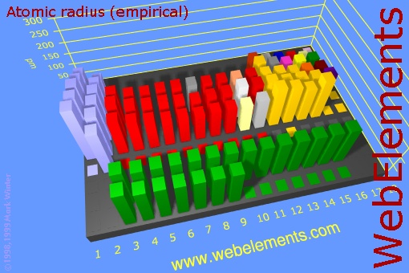
Atomic Radius
The overall trend in atomic radius looks like this.

Slide 47
Electron Affinity
Predict the trend on whiteboard
What does the word ‘affinity’ mean?
Electron affinity is the energy change that occurs when an atom gains an electron (in kJ).
Cl + e⁻ ⎯⎯→ Cl⁻ + energy
Where ionization energy is always endothermic, electron affinity is usually exothermic → energy is released when an electron is added.

Slide 48
EA Trend down a group
Atoms further down a group have increasing resistance to receiving an extra electron and thus less positive electron affinities (E.A. becomes smaller)
Increasing distance from the nucleus and shielding means the electron- electron repulsion increases when an extra electron is added for atoms further down the group

Slide 49
EA Trend across a period
In general, electron affinity becomes more exothermic as you go from left to right across a row (easier to add an electron, more energy given off)
Since there will be less nuclear force acting on the outermost electrons of elements to the left, electron-electron repulsion becomes more substantial when an electron is added to each atom.

Slide 50
Electron Affinity
Your sheet should look like this:
Notes:
Replace this to

Slide 51
Electronegativity
Electronegativity is a measure of an bonded atom’s ability to attract electrons.
It is an arbitrary scale that ranges from 0 to 4.
The units of electronegativity are Paulings.
Generally, metals are electron givers and have low electronegativities.
Nonmetals are electron takers and have high electronegativities.
What about the noble gases?
Notes:
NOTE: WE COME BACK TO ELECTRONEGATIVITY NEXT UNIT, NO CALCULATING HERE BUT POINT OUT VALUES ON TABLE. Should be able to do trends questions takeup, electronegativity, then quantum intro in a period

Slide 52
Electronegativity
Your sheet should look like this:
0

Slide 53
Overall Reactivity
This ties all the previous trends together in one package.
However, we must treat metals and nonmetals separately.
The most reactive metals are the largest since they are the best electron givers.
The most reactive nonmetals are the smallest ones, the best electron takers.

Slide 54
Overall Reactivity
Your summary sheet will look like this:
0
Notes:
Ended here per 1 tues (2016)

Slide 55
The End
Notes:
End here

Slide 56
Moving across a period
Answer: AR decreases
What is the same:
# of inner electrons
What is changing:
Zeff increasing (more attraction)
e-e repulsion increasing with each addition, but only slightly
Overall: attractive force is greater, resulting in a decrease
Notes:
Answer: to question about noble gases 2 slides ago, they have 0 electronegativity

Slide 57
Moving down a group
Atomic Radius increases
What is the same:
Zeff
e-e repulsion in outer shell
What is changing:
Number of inner complete shells: contributes a lot to e-e repulsion (shielding effect)
Overall: repulsion is greater, resulting in a increase in AR

Slide 58
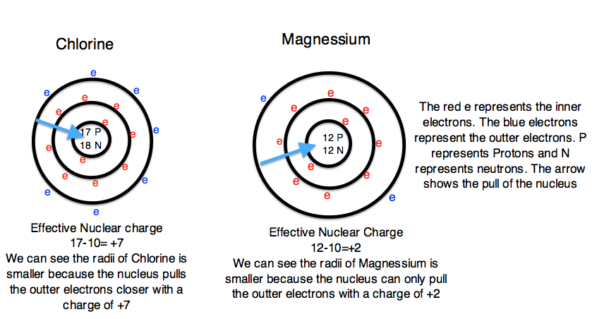
http://chemwiki.ucdavis.edu/@api/deki/files/1175/effective_nuclear_charge.png?size=bestfit&width=614&height=328&revision=1

Slide 59
Cation Formation
Na atom
1 valence electron
Effective nuclear charge on remaining electrons increases.
11p+
Remaining e- are pulled in closer to the nucleus. Ionic size decreases.
Valence e- lost in ion formation
Result: a smaller sodium cation, Na⁺

Slide 60
Anion Formation
A chloride ion is produced. It is larger than the original atom.
Chlorine atom with 7 valence e-
17p+
One e- is added to the outer shell.
Effective nuclear charge is reduced and the e- cloud expands.

Slide 61
